Slide 1
Twinning project ENEA – ENforcing Environmental Acquis
5th Steering Committee
César Seoánez
Skopje, 22nd of April, 2016

Slide 2
OUTLINE
5th quarter assessment (12 January – 11 April 2016)
Quarterly Report 5
Programme until end of implementation (12 April – 11 August 2016)
Operative Side Letter 6
Outputs delivered to Steering Committee

Slide 3
Coordination
5th QUARTER:
Meetings: multiple, within missions, with stakeholders, specially industry & projects
No further meetings with Inspection Council, info exchanged by email
E-inspection software project for Inspection Council cancelled
Coordination with TA project supporting local level
Workshop & feedback to TA Programme of Reform
Exchange of info about trainings and mutual invitation to participate
Coordination with Twinning IED
2 meetings in February & March to provide detailed info and suggestions
All relevant outputs shared

Slide 4
Communication
5th QUARTER:
Website: www.sei.gov.mk
All supporting materials, incl. inspection manual, sector factsheets & insp. checklists
2 new sections: info for industry & Frequently Asked Questions
Link to web of Twinning IED included
Info about project for MoEPP’s web provided in March
Some additional visibility materials ready to be delivered (USB, bags)

Slide 5
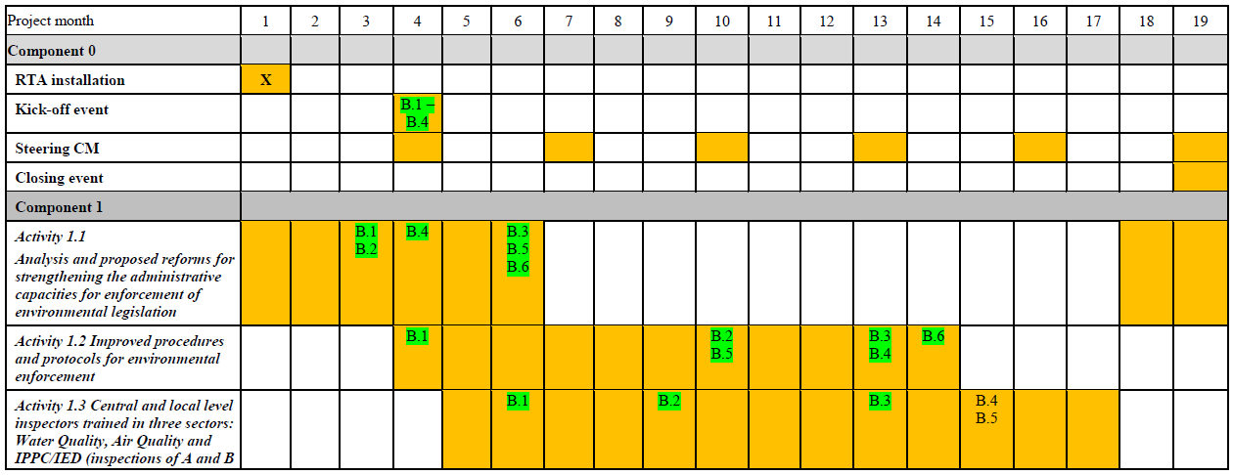
Progress vs. Work Plan
5th QUARTER:

Slide 6
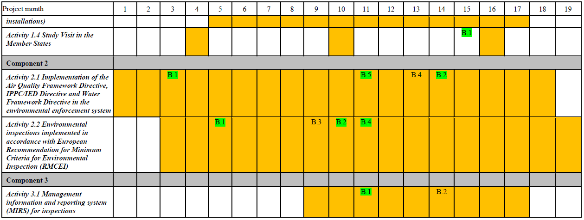
Progress vs. Work Plan
5th QUARTER:
Good

Slide 7
Activities
5th QUARTER:
January (starting 12th )
Activity 1.2, mission 6: 2nd mission for check lists waste streams
Activity 2.1, mission 8: control & remediation of old polluted sites
Activity 1.2, mission 11: 1st mission info operators & communication strategy

Slide 8
Activities
5th QUARTER:
February
Activity 2.1, mission 7: other supporting documents
Steering Committee 4
Activity 3.1, mission 2: proposals for BPMS improvement
Activity 1.2, mission 12: 2nd mission to finalise info operators & comm strategy
Final feedback to draft Law for Inspection on Environment

Slide 9
Activities
5th QUARTER:
March
Activity 1.3, mission 4: 2 two-days trainings on industrial processes (regions 1 & 2)
Activity 1.3, mission 5: 2 two-days trainings on industrial processes (regions 3 & 4)
Activity 1.3, mission 6: training based on inspection to pilot installation (region 1)
April (until 11th )
Addendum 2 endorsed
Activity 1.4, mission 3: study visit to The Netherlands

Slide 10
Activities
5th QUARTER:
Main outputs
SEI - Twinning website, with new sections
Finalised inspection manual
Finalised sector inspection checklists & factsheets (12 sectors)
Trainings on industrial processes, and first pilot inspections
Draft Law for Inspection on Environment ready for Parliament
Info for industries, including leaflet
Report & template of publicly available inspection report

Slide 11
Activities
5th QUARTER:
Main outputs
Finalised proposals for indicators to evaluate inspectorate & inspectors
Report about SEI contribution for EU reporting obligations
Report about inspection duties related to EU legislation on shipments of waste
Report with recommendations on soil pollution prevention, control & management
SEI’s BPMS updated proposals for next steps

Slide 12
Activities
5th QUARTER:
Other outputs
Recommendations to deal with OHIS polluted site
Useful guidance docs & legislation on soil prevention & conceptual site model
Addendum 2

Slide 13
Participation BC experts
5th QUARTER:
154 BC participants in meetings held in missions
Drafting of documents finished, trainings started

Slide 14
Expenditures
5th QUARTER:
As planned, only 1 mission with 1 expert less
Savings in flight tickets
In 5th quarter ~ 16.5 % of activities’ budget

Slide 15
QUARTERLY REPORT
Draft Law → proceed fast to send to Parliament
Inspection Council should address Twinning docs sent,
to align to EU best practices
Overload in planning & reporting, evaluation of inspectors with financial penalties...
Managers in SEI, MoEPP, CFCD, DEU & SEA should continue pushing for a change in Law for Insp. Supervision
Create Network of Environmental Inspectors
Post-Twinning cooperation between twinned Partners

Slide 16
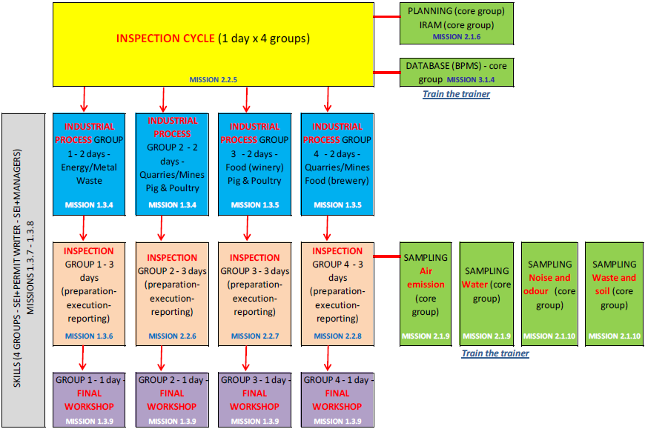
PROGRAMME UNTIL END → TRAINING
April-May
April-June
June
April-May
July

Slide 17
PROGRAMME UNTIL END
April
Activity 1.3, mission 7: 3 one-day trainings on comm. skills & team building
Activity 2.2, mission 6: training based on inspection to pilot installation (region 3)
Steering Committee 5: 22nd April
Activity 3.1, mission 3: training on use of IRAM software

Slide 18
PROGRAMME UNTIL END
May
Activity 1.3, mission 8: 3 one-day trainings on comm. skills & team building
Activity 2.2, mission 7: training based on inspection to pilot installation (region 2)
Activity 3.1, mission 3: further work on BPMS
Updated project’s brochure

Slide 19
PROGRAMME UNTIL END
June
Activity 2.2, mission 8: training based on inspection to pilot installation (region 4)
Activity 2.1, mission 9: first training on sampling & monitoring
Activity 2.1, mission 10: second training on sampling & monitoring
Activity 3.1, mission 4: final mission BPMS

Slide 20
PROGRAMME UNTIL END
July
Closure event: 7th July
Activity 1.3, mission 9: four 1-day workshops to close training programme
Activity 1.1, mission 6: follow-up projects
Steering Committee 6: 21st July
August(until 11th)
Closure of project, final reporting

Slide 21
OPERATIVE SIDE LETTER 6
Builds upon Addendum 2
Explicit approval of OSL is very welcome
Next week: side letter 11 (increase 1 day mission 1.3.8, to
train-the-trainers)

Slide 22
COMMENTS TO OUTPUTS DELIVERED TO ST.C.?
1.2.6 & 1.2.8 – final version of 12 sector & waste inspection checklists
1.2.12 – final version of inspection manual
1.2.12 – Info for industries, leaflet and communication strategy
1.2.12 – Report & template of publicly available inspection report
2.1.7 – Report about SEI contribution for EU reporting obligations
2.1.7 – Report about inspection duties related to EU legislation on shipments of waste
3.1.2 – SEI’s BPMS updated proposals for next steps

Slide 23
Thank you very much !
Благодарам многу!
www.sei.gov.mk
blinkov_d@yahoo.com
inspection.cs@gmail.com

