Slide 1
Twinning Environmental Inspection: Progress, ideas and collaboration proposals
José Francisco Alonso Picón
Rob Kramers
César Seoánez
Skopje, 22nd April 2016
Twinning project - MK 10 IPA EN 01 14 (MK 10 IB EN 01)
ENEA – ENforcing Environmental Acquis

Slide 2
OUTLINE
1. Who we are
2. The Project: progress
3. Ideas & collaboration proposals
4. Conclusions

Slide 3
Who we are
Spanish Project Leader: Dr. José Francisco Alonso Picón
36 years of experience in inspection in different areas
4 years in customs & taxes (national)
6 years in health & food control
Galicia region
(approx. as
Macedonia)
26 years in civil protection & environmental inspection
Responsible for creation & lead of Environmental Inspectorate
Creator & first president of Spanish Network of Env. Inspection (REDIA)
Active role in IMPEL & EU Twinnings (Turkey, Macedonia)

Slide 4
Who we are
Dutch Project Leader: Mr. Rob Kramers
26 years of experience in environmental inspection, methodology & capacity building
13 years as senior inspector in North Holland region
13 years in Env. Knowledge Centre InfoMil
Developing methodology for inspection planning
Support & training to env. permit officers & inspectors
Coordinator of international activities
Key role in IMPEL, authoring or co-authoring numerous guidances in env. inspection
which are reference for Environmental Inspectorates in EU
Experience in multiple countries of Balkans, Eastern Europe & others

Slide 5
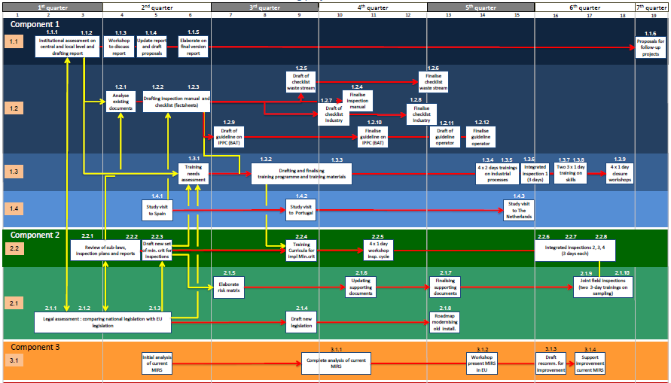
PROJECT’S PROGRESS
Since January 2015:
19 EU senior inspectors & 2 legal experts:
7 Spanish, 8 Dutch, 2 Polish, 1 German, 1 Italian, 1 Greek & 1 Croatian: broad EU view
On average >15 years of experience
41 one-week missions with EU inspectors & legal experts → continuous
3 study tours to Spain, The Netherlands & Portugal

Slide 6
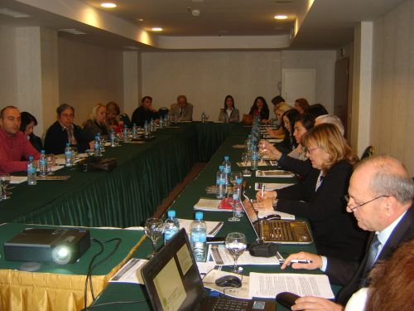
PROJECT’S PROGRESS
Improvement of system:
 | BEFORE PROJECT | NOW
1 | No gap analysis comparing with EU standards | Assessment report (institutional & legal) Report with strategy & proposals for improvement
2 | Legislation not in line with EU legislation related to env. Inspection (IED, RMCEI…) | Draft of Law for Inspection on Environment Table of Concordance with IED, RMCEI…
3 | Planning of env. Inspections not in line with EU standards | EU IMPEL risk assessment IRAM software adapted to Macedonia, and trainings ongoing
4 | Current system to evaluate Inspectorate & inspectors | Proposals on performance indicators to evaluate Environmental Inspectorate & inspectors

Slide 7
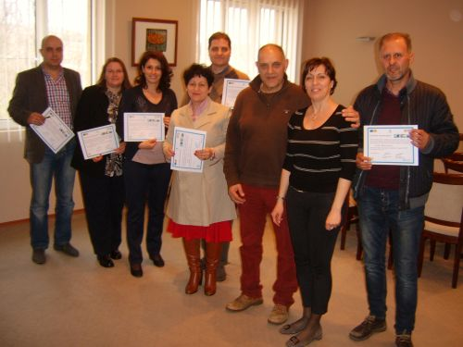
PROJECT’S PROGRESS
Training & capacity building:
 | BEFORE PROJECT | NOW
5 | No/limited training to adapt to EU env. Inspection standards | Training needs assessment report Training programme within Twinning: Knowledge of sectors & techniques Inspections to pilot installations (2 more in 25-27 May & 30 May – 2 June) Sampling & analysis of self-monitoring reports of installations Skills (communication, team building) Report with training curricula & long-term capacity building proposals 3 study tours → Dutch Inspection Council

Slide 8
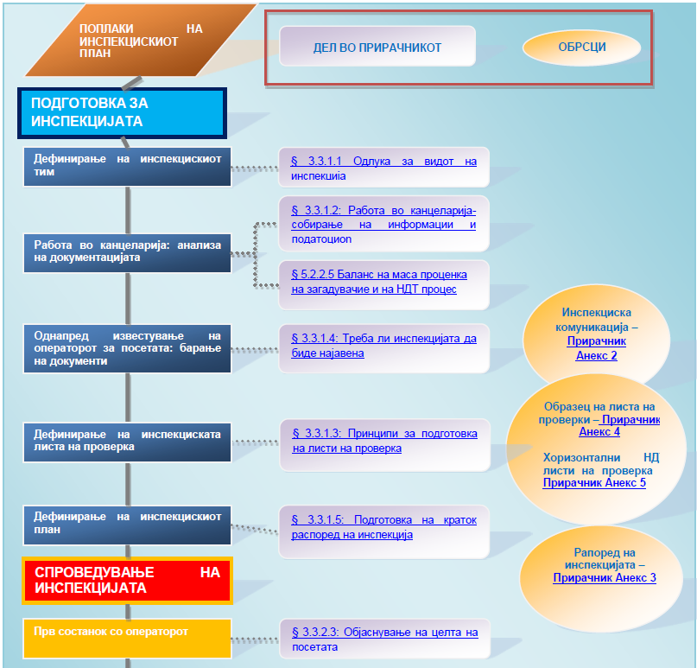
PROJECT’S PROGRESS
Guidance documents/templates:
 | BEFORE PROJECT | NOW
6 | No environmental inspection manual | Environmental Inspection Manual in line with EU best practice
7 | No inspection checklists or info about sectors and how to minimize their impact | 1 Generic env. inspection checklist 1 Horizontal BAT inspection checklist 12 sector env. inspection checklists 12 sector factsheets (to know sector & techniques to minimise its pollution)
8 | No template for inspection report | Template for inspection report for IED (large) installations (at least)

Slide 9
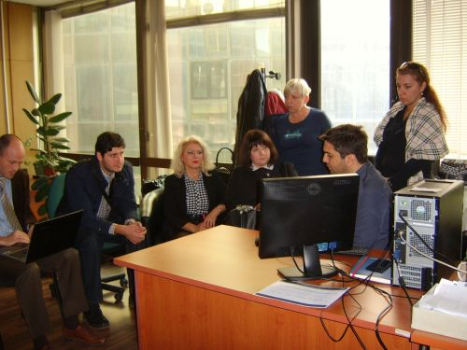
PROJECT’S PROGRESS
Software to support Inspectorate:
 | BEFORE PROJECT | NOW
9 | Current software to manage documents linked to inspections | Proposals to improve & upgrade software

Slide 10
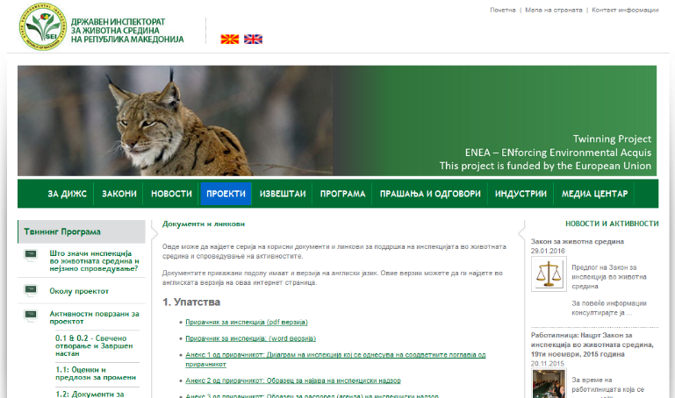
PROJECT’S PROGRESS
Communication & visibility:
 | BEFORE PROJECT | NOW
10 | No written standard information to operators | Leaflet for operators
11 | No web | SEI website, including info for operators, Frequently Asked Question, legislation, all guidance documents… www.sei.gov.mk

Slide 11
IDEAS & COLLABORATION PROPOSALS
Event/workshop to promote use of EU funds by Inspectorates
With EU Delegation
Twinning, Technical Assistance, Supply
Sharing experiences by Inspectorates with projects
EU Funds are an extraordinary tool to raise substantially capacity
Brainstorming about the future

Slide 12
IDEAS & COLLABORATION PROPOSALS
Ideas for Law on Inspection (ZIN), to improve performance and
impact of SEI (some apply to all Inspectorates)
Based on (long) EU experience + detailed assessment of current situation

Slide 13
IDEAS & COLLABORATION PROPOSALS
Plans & reports → Annual & Multiannual
Multiannual : to define strategy in line with Ministry and have larger impact
Annual : more specific, based on multiannual & (environmental) risk assessment
Shorter periods: burden reducing substantially efficiency, absent in EU
Delete or derogate until a software automatising process is in place

Slide 14
IDEAS & COLLABORATION PROPOSALS
Evaluation of environmental inspection
Until now, (minimum) number of inspections has been the key indicator
Typical numbers / SEI inspector / month : 12 ordinary + 8 extraordinary
Experience in EU & integrated inspections:
Well-prepared, executed and followed-up inspections are essential to have impact
In the case of environmental inspections, it is impossible to combine good & fast
Why? Because to assess environmental impact, each installation & sector is different,
and the number of factors to take into account and evaluate is extremely
large and variable, specially in integrated inspections
Large polluters → Integrated assessment is mandatory → IPPC Directive & IED

Slide 15
Complexity of environmental inspections
Minimum days for integrated environmental inspections (Galicia, Spain) :
IPPC inspections, BEFORE Industrial Emissions Directive (IED):
AFTER IED:
 |  | IPPC PERMIT |  | IPPC FILE |  | INSPECTION |  |  | TOTAL OF DAYS
 |  | Study | Upload | Study | Upload | Office work | Facility inspection | Report
SECTOR | Farming and livestock sector | 0,5 | 1 | 1 | 1 | 1 | 1 | 1 | 7
 | Food industry | 1 | 2 | 4 | 2 | 2 | 2 | 2 | 15
 | Industrial | 1 | 2 | 4 | 2 | 2 | 2 | 2 | 15
 | Waste Manager | 2 | 2 | 4 | 2 | 2 | 2 | 2 | 16
 |  | IPPC PERMIT |  | IPPC FILE |  | INSPECTION |  |  |  |  |  | TOTAL OF DAYS | Increase of days with respect to IPPC
 |  | Study | Upload | Study | Upload | Office work | Facility inspection | Certificate, checklist and others (photographic report / complementary report) | Report 1 | Review of appeals | Report 2 (final)
SECTOR | Farming and livestock sector | 0,5 | 1 | 1 | 1 | 1 | 2 | 2 | 0,5 | 1 | 0,5 | 11 | 4
 | Food industry | 1 | 2 | 4 | 2 | 2 | 3 | 3 | 1 | 1 | 1 | 20 | 5
 | Other Industry | 1 | 2 | 4 | 2 | 2 | 3 | 3 | 1 | 1 | 1 | 20 | 5
 | Waste Manager | 2 | 2 | 4 | 2 | 2 | 3 | 4 | 2 | 1 | 2 | 24 | 8

Slide 16
IDEAS & COLLABORATION PROPOSALS
Evaluation of environmental inspection
Experience in EU & integrated inspections:
Integrated inspections promote deep understanding and solve real problems
Urgent need for integrated inspections, few but in depth
Evaluation of (environmental) inspectors:
When number of inspection is important → low quality, no impact
Indicators related to quality & outcome need to have a large weight
Best done by Director or board within Inspectorate, who knows all factors in depth
Bonuses good, penalisations damage: better bonuses depending on responsibility
Evaluation as tool for: training needs assessment, detect gaps in team & motivation,
focusing actions towards more efficiency

Slide 17
IDEAS & COLLABORATION PROPOSALS
Inspection Council
Inclusion of Directors of Inspectorates
Several years of experience in inspection

Slide 18
IDEAS & COLLABORATION PROPOSALS
Brainstorming sessions for experience sharing
On topics of your interest (ideal if told in advance)
Whenever we have experts available:
Today (afternoon)
28 April (afternoon): Horst Büther
9 May or 12-13 (afternoon): Marc du Maine & Bram Segijn
30 May: Picón
Event/workshop to promote use of EU funds by Inspectorates
Meeting with Dutch Inspection Council
We are at your disposal, open to suggestions

Slide 19
CONCLUSIONS
Hope to provide some input to increase impact of Inspectorates
Challenging, but with opportunities & available experiences
Eager to work with you, learn & strengthen ties
Благодарам многу!

